Slide 1

Building Trust in Modern Computing Platforms
Aritra Dhar
ETH Zurich

Slide 2

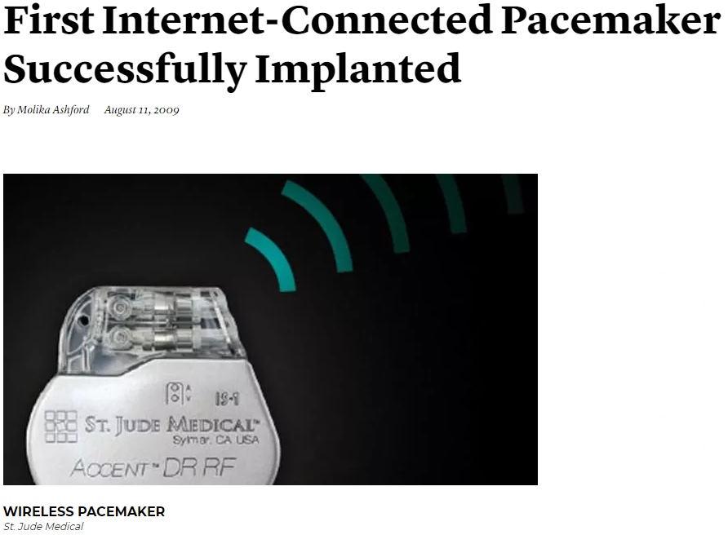


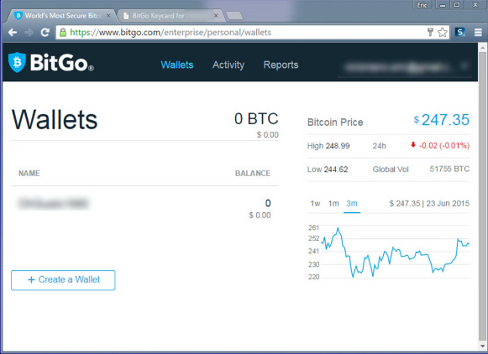
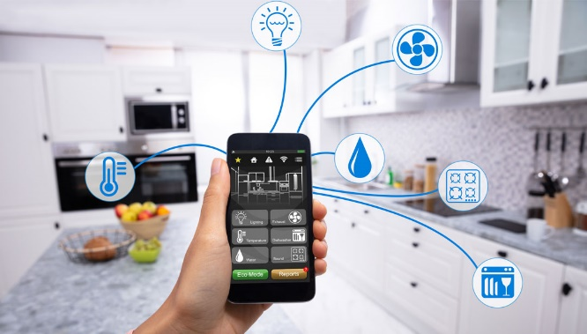
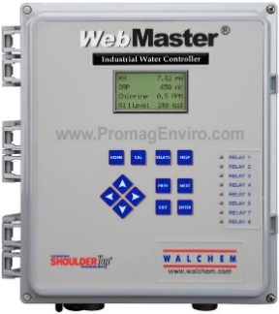
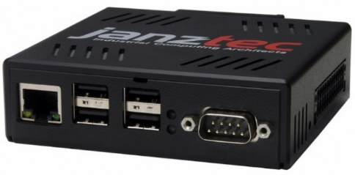
Remote safety/security-critical systems
Images are from janztec, wired, getty, controlbyweb
Notes:
First I will motivate you with some relevant examples that involves remote safety and security critical systems. Automation in industrial sector is getting more prevalent today and more and more of our critical infrastructure such a the electricity grid, gas pipelines, are monitored and actuated by these PLC or programmable logic controller. Compared to traditional PLCS, these are often web-enabled, i.e., they are networked attached and provide a web UI. The operators can remotely connect to the devices, monitor and actuate the equipments.
Other critical systems such as medical implants such as a pacemaker are becoming more and more smart so that a medical technicians can connect to them and monitor vitals or change some operational parameters. Smart homes are also another example where IoT devices report the current state of the home and user can operate them remotely. They also provide web or mobile enabled UI. Other, more traditional use cases could be financial transaction. And more and more people, specially during pandemic are opting for these web services.

Slide 3

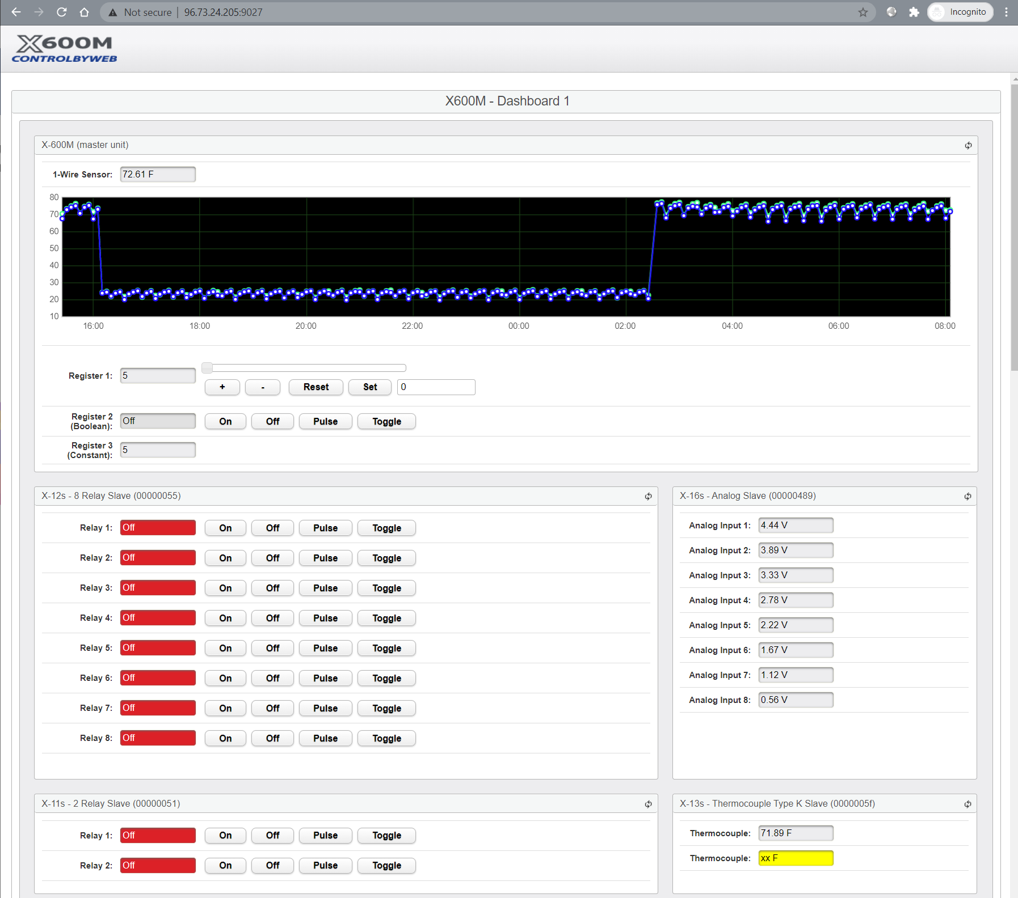
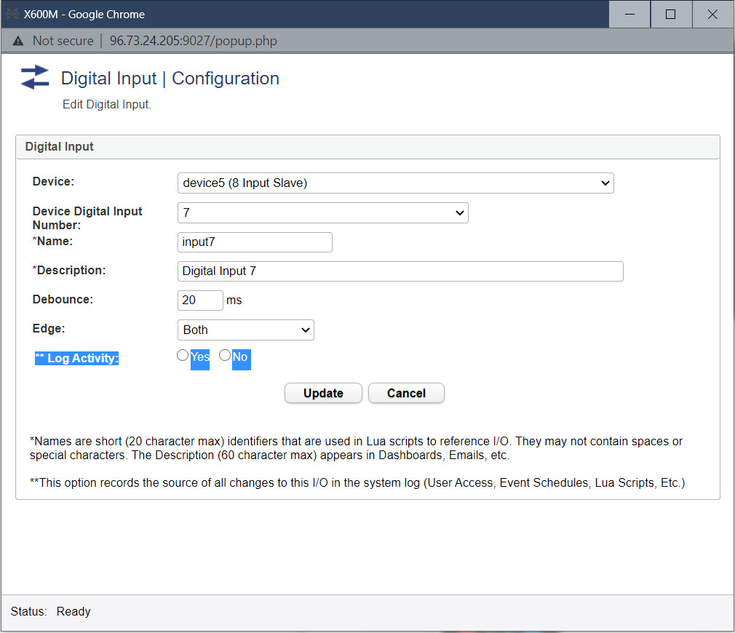
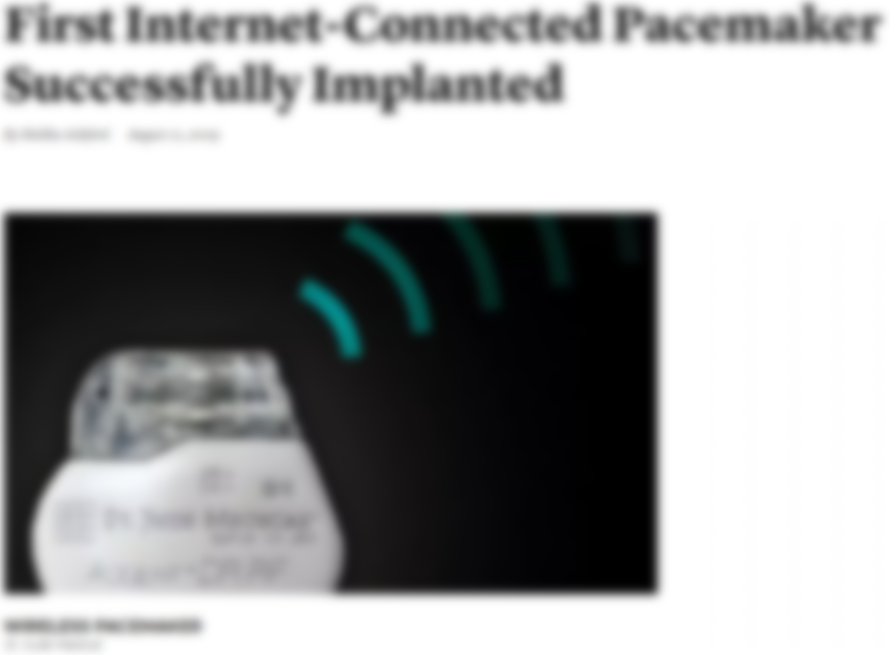








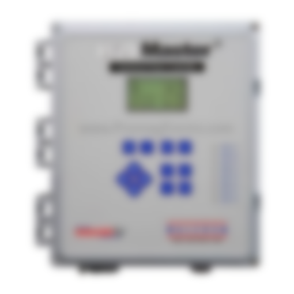



Remote safety/security-critical systems
Images are from janztec, wired, getty, controlbyweb

Slide 4







Large TCB $→$ Large Attack Surface
25.16M
20.92M
2M
36.68M
600K
CPU microcode
Device firmware
Device drivers

Slide 5






Concrete Attack Scenario
Insulin Pump config
Heart beat
75
65
Insulin (U)
177
Basal rate (U/Hr)
0.025
Low limit (mg/dL)
60
High limit (mg/dL)
105
Program
Cancel
Aritra Dhar

Slide 6






Remote Trusted path for IO
User
IO devices
Host
Remote System

Slide 7






Trusted Execution Environment (TEE)
TCB
App
App
App
App
App
Enclave
Operating System
Operating System
Dev
DRAM
CPU
Dev
DRAM
CPU
TCB
TCB
Traditional platforms
Intel SGX
OS still manages devices
Static HW TCB
Trusted path is challenging

Slide 8

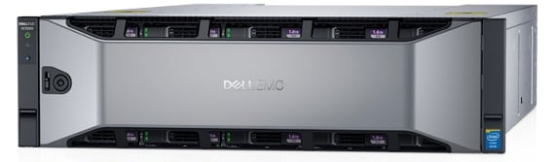
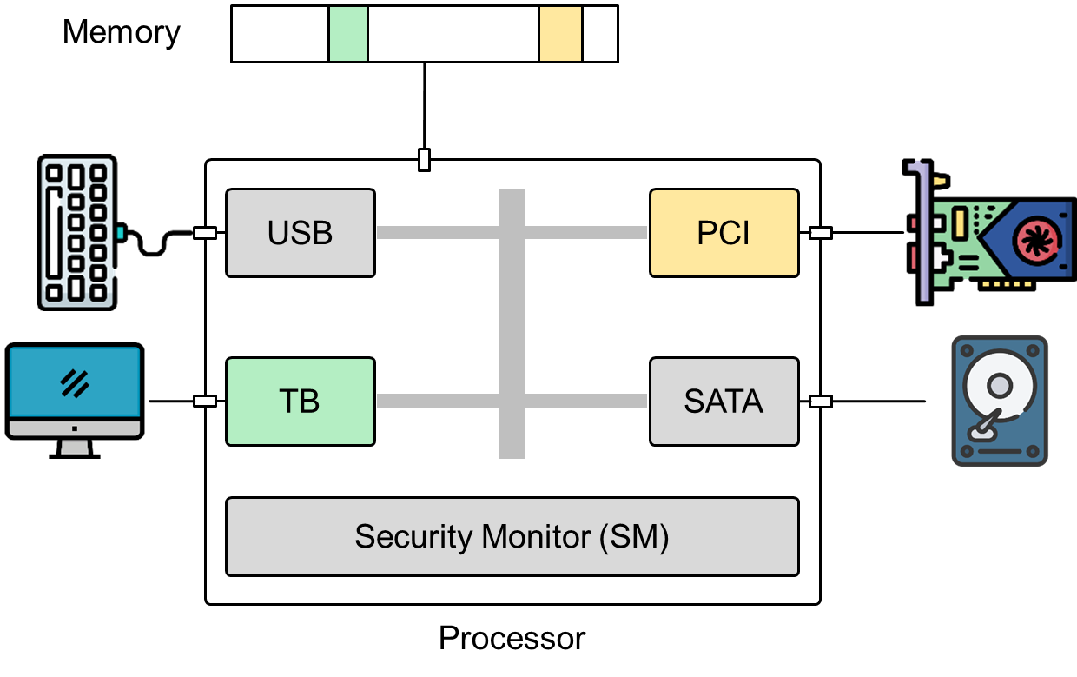

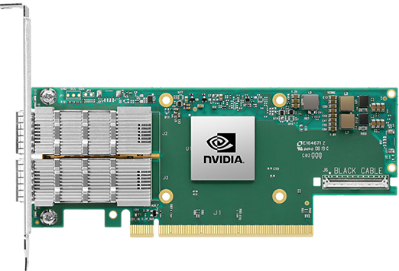
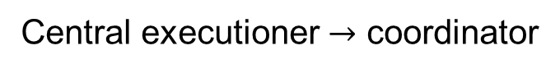
Disaggregated computing
Traditional CPU-centric model
Central executioner $→$ coordinator
Images are from nVidia, Dell, Mellanox official websites

Slide 9






My Contribution
IntegriKey (2017, eprint: 2017/1245)
ProtectION (NDSS 2020)
IntegriScreen (2018, arXiv:2011.13979)
Remote system
Remote trusted path application
Notes:
In the beginning of the my doctoral research I started first with IntegriKey and then Integriscreen. The former is based on the idea of input signing to provide only input integrity. Integrikey also identifies a new form of UI attack that we called label swapping attack where the attacker can swap the labels of input element. IntegriScreen provide IO integrity by using a smartphone camera using a concept that we coined visual supervision of user input. While these two works made a substantial progress over state of the art trusted path, we late identify some fundamental pitall not only in them but also almost every existing research….

Slide 10
My Contribution
IntegriKey (2017, eprint: 2017/1245)
ProtectION (NDSS 2020)
IntegriScreen (2018, arXiv:2011.13979)
Remote system
Remote trusted path application
ProximiTEE (CODASPY 2020)

Slide 11

My Contribution
IntegriKey (2017, eprint: 2017/1245)
ProtectION (NDSS 2020)
IntegriScreen (2018, arXiv:2011.13979)
Remote system
Remote trusted path application
Dedicated Security Chips in the Age of Secure Enclaves (IEEE S&P magazine 2020)
ProximiTEE (CODASPY 2020)

Slide 12



My Contribution
PIE (2020, arXiv:2010.10416)
IntegriKey (2017, eprint: 2017/1245)
ProtectION (NDSS 2020)
IntegriScreen (2018, arXiv:2011.13979)
Remote system
Remote trusted path application
Dedicated Security Chips in the Age of Secure Enclaves (IEEE S&P magazine 2020)
ProximiTEE (CODASPY 2020)

Slide 13
My Contribution
PIE (2020, arXiv:2010.10416)
IntegriKey (2017, eprint: 2017/1245)
ProtectION (NDSS 2020)
IntegriScreen (2018, arXiv:2011.13979)
Remote system
Remote trusted path application
Dedicated Security Chips in the Age of Secure Enclaves (IEEE S&P magazine 2020)
ProximiTEE (CODASPY 2020)

Slide 14
Today’s Talk
PIE (2020, arXiv:2010.10416)
IntegriKey (2017, eprint: 2017/1245)
ProtectION (NDSS 2020)
IntegriScreen (2018, arXiv:2011.13979)
Remote system
Remote trusted path application
Dedicated Security Chips in the Age of Secure Enclaves (IEEE S&P magazine 2020)
ProximiTEE (CODASPY 2020)

Slide 15
ProtectIOn setting
ProtectION (NDSS 2020)
Remote system
Remote trusted path application

Slide 16







Solution 1: Transaction Confirmation Device
Insulin pump config
Heart beat
75
Insulin (U)
177
Basal rate (U/Hr)
0.025
Android Protected Confirmation
You are going to program
Heart beat 75
Insulin 177U
Basal rate 0.025 U/Hr
Low level 60 mg/dL
High level 105 mg/dL
And more ……
Low limit (mg/dL)
60
Android Protected Confirmation
You are going to program
Heart beat 75
Insulin 171U
Basal rate 0.025 U/Hr
Low level 62 mg/dL
High level 125 mg/dL
And more ……
High limit (mg/dL)
105
Program
Cancel
Notes:
Many of you missed the changes…

Slide 17



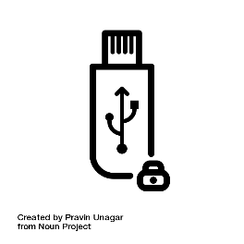
Solution 2: Input Signing
Insulin pump config
Heart beat
75
Insulin (U)
177
Heart beat 75
Insulin 177U
Basal rate 0.025 U/Hr
Low level 60 mg/dL
High level 105 mg/dL
Basal rate (U/Hr)
0.025
Low limit (mg/dL)
60
Trusted embedded device
High limit (mg/dL)
105
Program
Cancel
Notes:
Add attacker in the host

Slide 18



Display manipulation attack
177
177
Insulin
17
7
1777
Insulin
177
User sees 177
Device records 1777
Host sends 1777

Slide 19
Observation 1
The lack of output integrity – the render of user inputs on the screen – compromises input integrity.

Slide 20

Solution 3: Overlay
Insulin Pump config
Insulin Pump config
Heart beat
Heart beat
75
Insulin (U)
Insulin (U)
177
Basal rate (U/Hr)
Basal rate (U/Hr)
0.025
Low limit (mg/dL)
Low limit (mg/dL)
60
High limit (mg/dL)
High limit (mg/dL)
105
Program
Cancel
Program
Cancel

Slide 21
Attack on Overlay: Output Manipulation
Insulin Pump config
Insulin Pump config
Heart beat
Insulin (U)
Insulin (U)
Heart rate
Basal rate (U/Hr)
Basal rate (U/Hr)
Low limit (mg/dL)
Low limit (mg/cc)
High limit (mg/dL)
High limit (mg/cc)
Program
Cancel
Program
Cancel

Slide 22

Overlay: Output Manipulation
Insulin Pump config
Insulin Pump config
Heart rate
75
Insulin (U)
177
Insulin (U)
177
Heart rate
75
Basal rate (U/Hr)
0.025
Basal rate (U/Hr)
0.025
Low limit (mg/dL)
60
Low limit (mg/cc)
0.6
High limit (mg/dL)
105
High limit (mg/cc)
1.05
Program
Cancel
Program
Cancel
Notes:
`Fix unit

Slide 23
Observation 2
If the protected output is provided out-of-context,
users are more likely not to verify it.
Therefore input integrity can be violated.

Slide 24
Overlay: Early Form Submission Attack
Insulin Pump config
Heart beat
75
Textbox in focus
Insulin (U)
17
Basal rate (U/Hr)
0.025
Low limit (mg/dL)
60
High limit (mg/dL)
105
OS triggers click
Program
Cancel

Slide 25
Observation 3
If not all the modalities of inputs are secured simultaneously,
none of them can be fully secured.

Slide 26






Requirements
The lack of output integrity – the render of user inputs on the screen – compromises input integrity.
Inter-dependency between Input and output

Slide 27
Requirements
If not all the modalities of inputs are secured simultaneously, none of them can be fully secured.
All modalities of input
Notes:
Mention that there is a proof, we keep it simple here

Slide 28
Requirements
If the protected output is provided out-of-context, users are more likely not to verify it. Therefore input integrity can be violated.
Low cognitive load
Notes:
Add the requirements under the icons

Slide 29
Requirements
Low TCB and easy deploy

Slide 30
Requirements

Slide 31








ProtectIOn
Low TCB + fast deployment
Input modalities
IOHub
Notes:
orientation

Slide 32

IO Integrity – Server-side Annotation
Remote device
Heart beat
<label for="insulin" secure="true">Insulin (U)</label> <input type="text" id="insulin" name="insulin" secure="true">
Insulin (U)
Basal rate (U/Hr)
Simultaneous IO
Low limit (mg/dL)
High limit (mg/dL)
Program
Cancel
ProtectIOn JS
<form action="/some_action", signature = "0x45AB…", id = "0x0ab..">

Slide 33


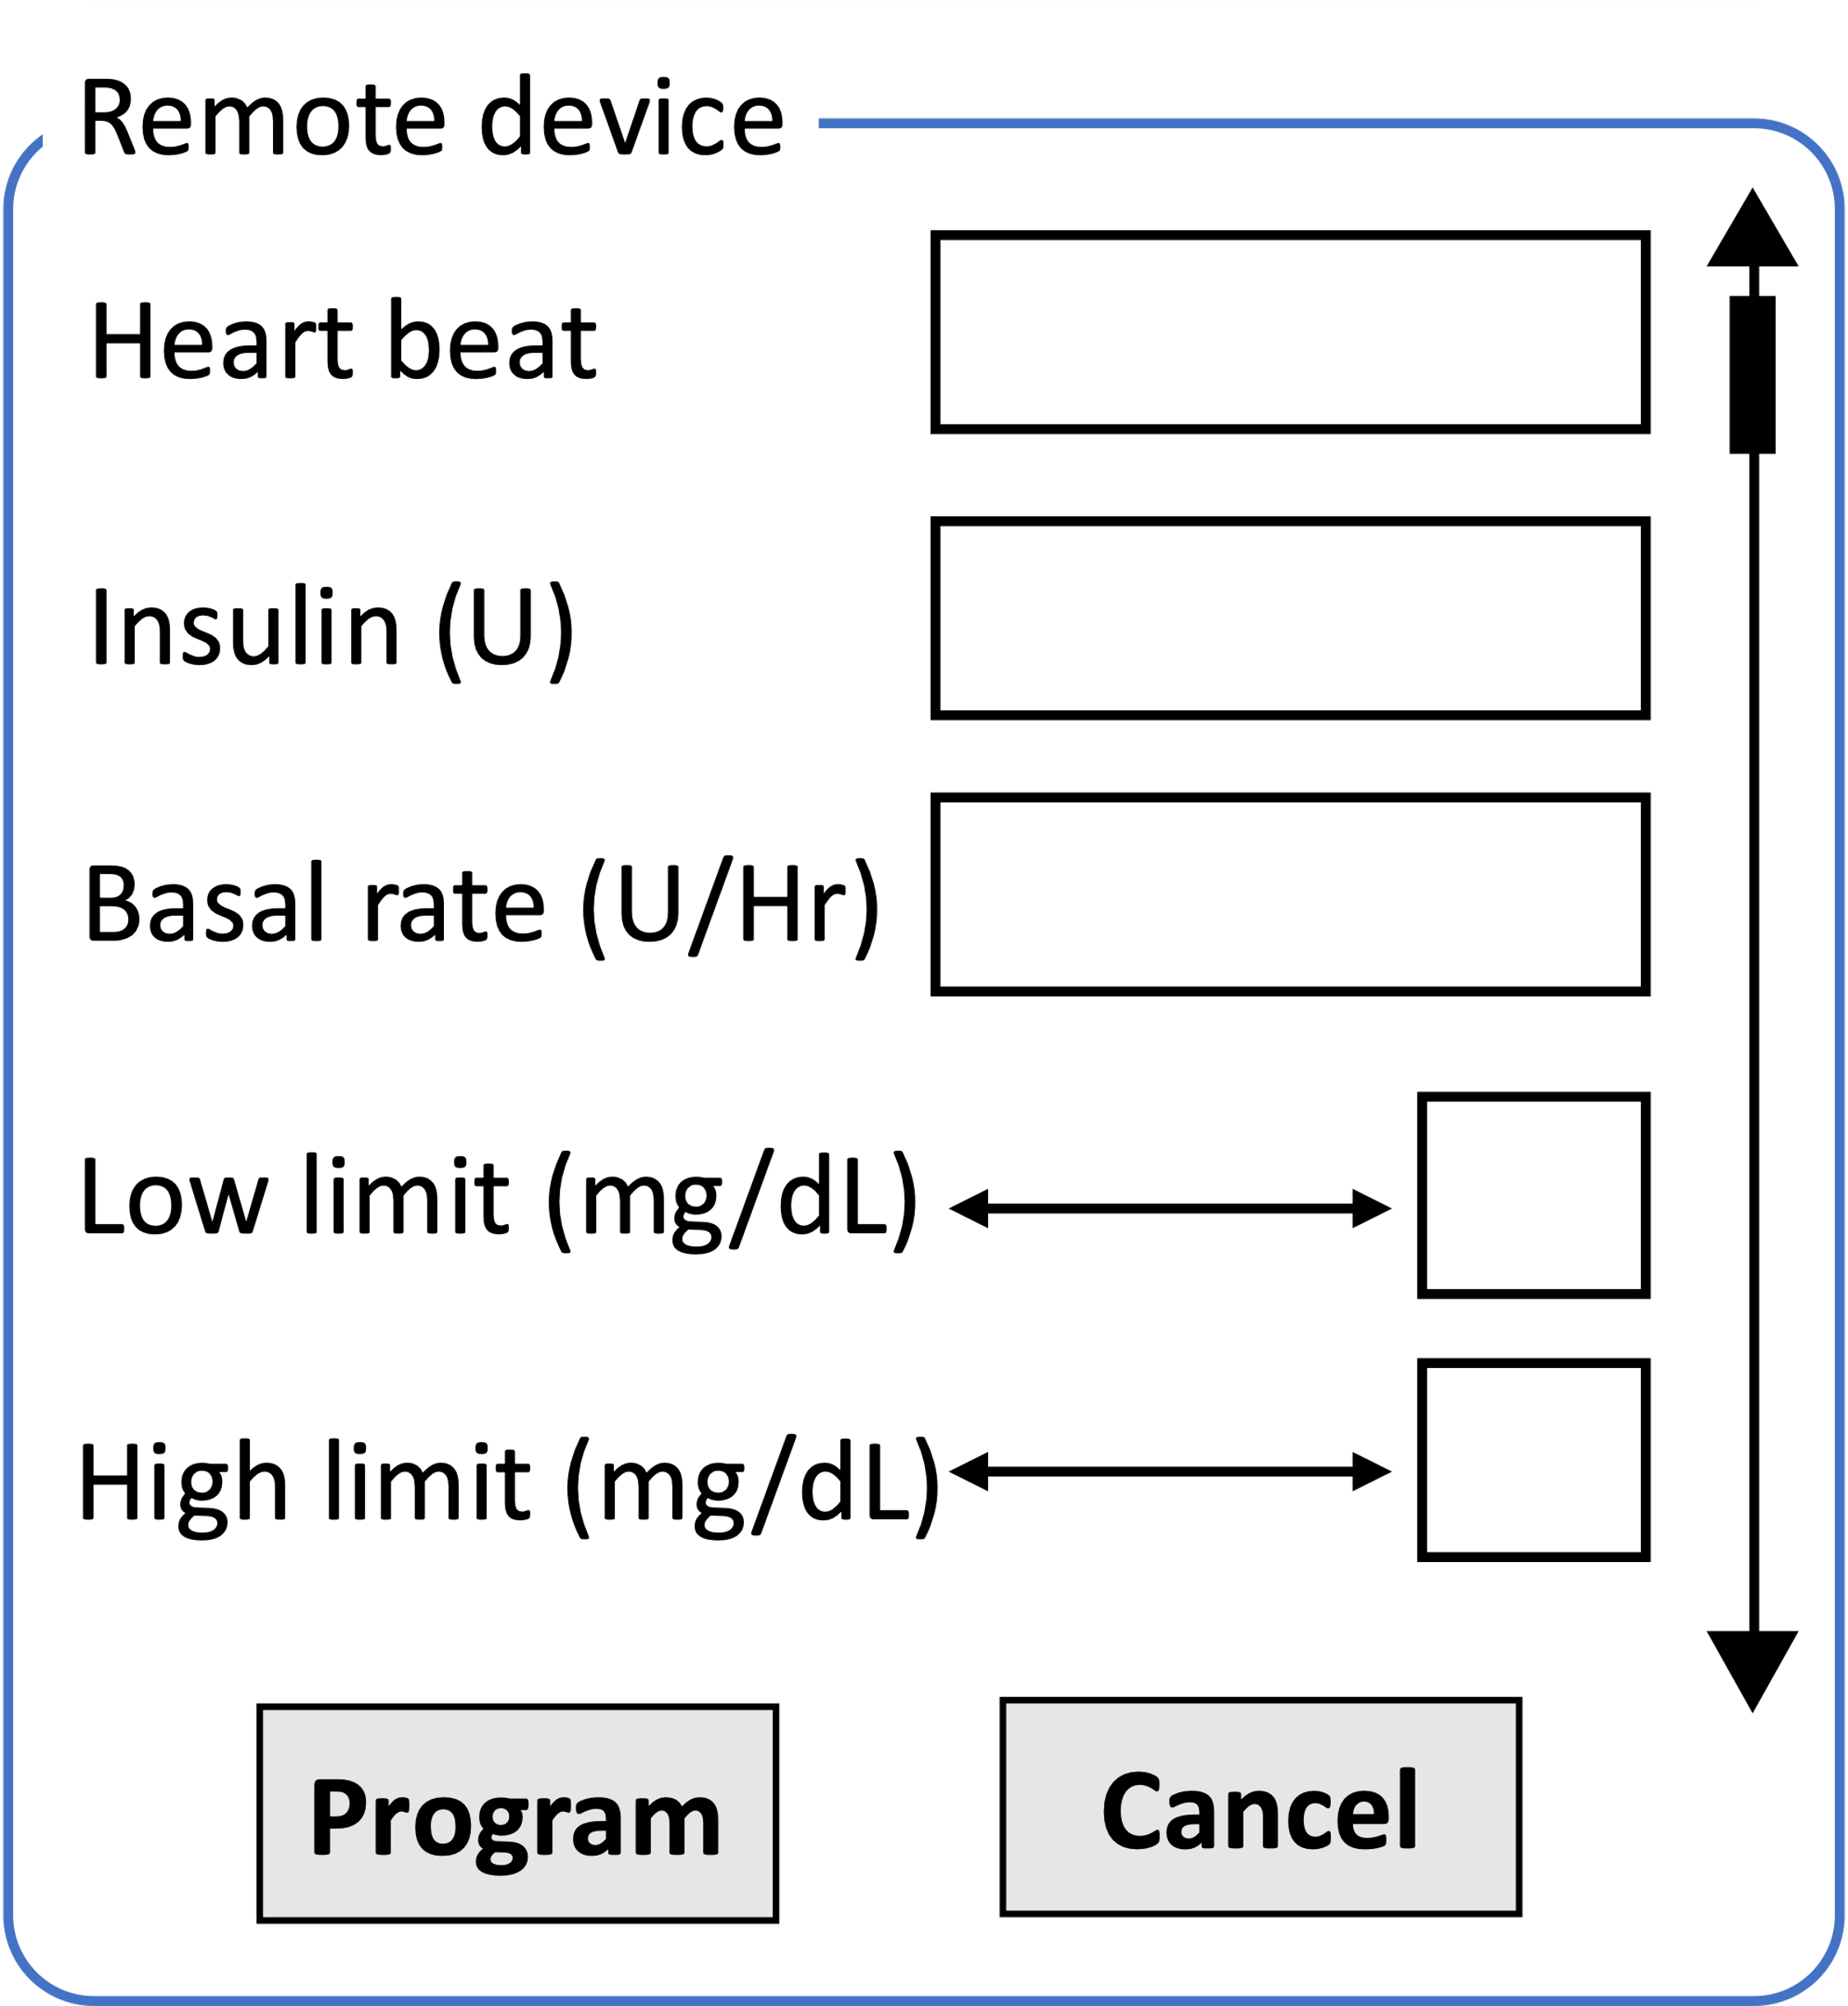
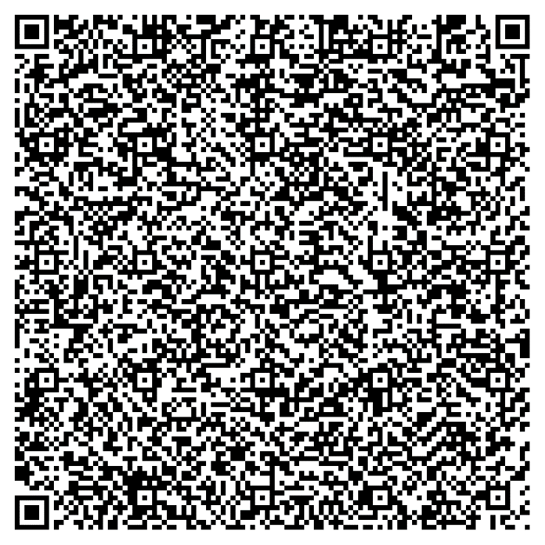
IO Integrity – HTML $→$ Specification
{
"formId": "form1",
"formName": "configure device",
"domain": "secure_site.io",
"size": "400*400",
"SAS": "5:LB",
"ui": [{
"id": "Insulin", "type": "textbox",
"label": “Insulin (U)",
"text":"",
"RE":(0-9)+},
{"id": "Heart rate",
…},
{"id":"b1",
"type": "button",
"label": "Program",
"trigger": "true"},
…],
"signature": "0x45AB...",
"id": "0x0ab.."}
<form action="/some_action", signature = "0x45AB…", id = "0x0ab..">
<label for="insulin" secure="true">Insulin
(U)</label> <input type="text" id="insulin"
name="insulin" secure="true"> …
</form>
ProtectIOn JS
Simultaneous IO
form1.bmp

Slide 34
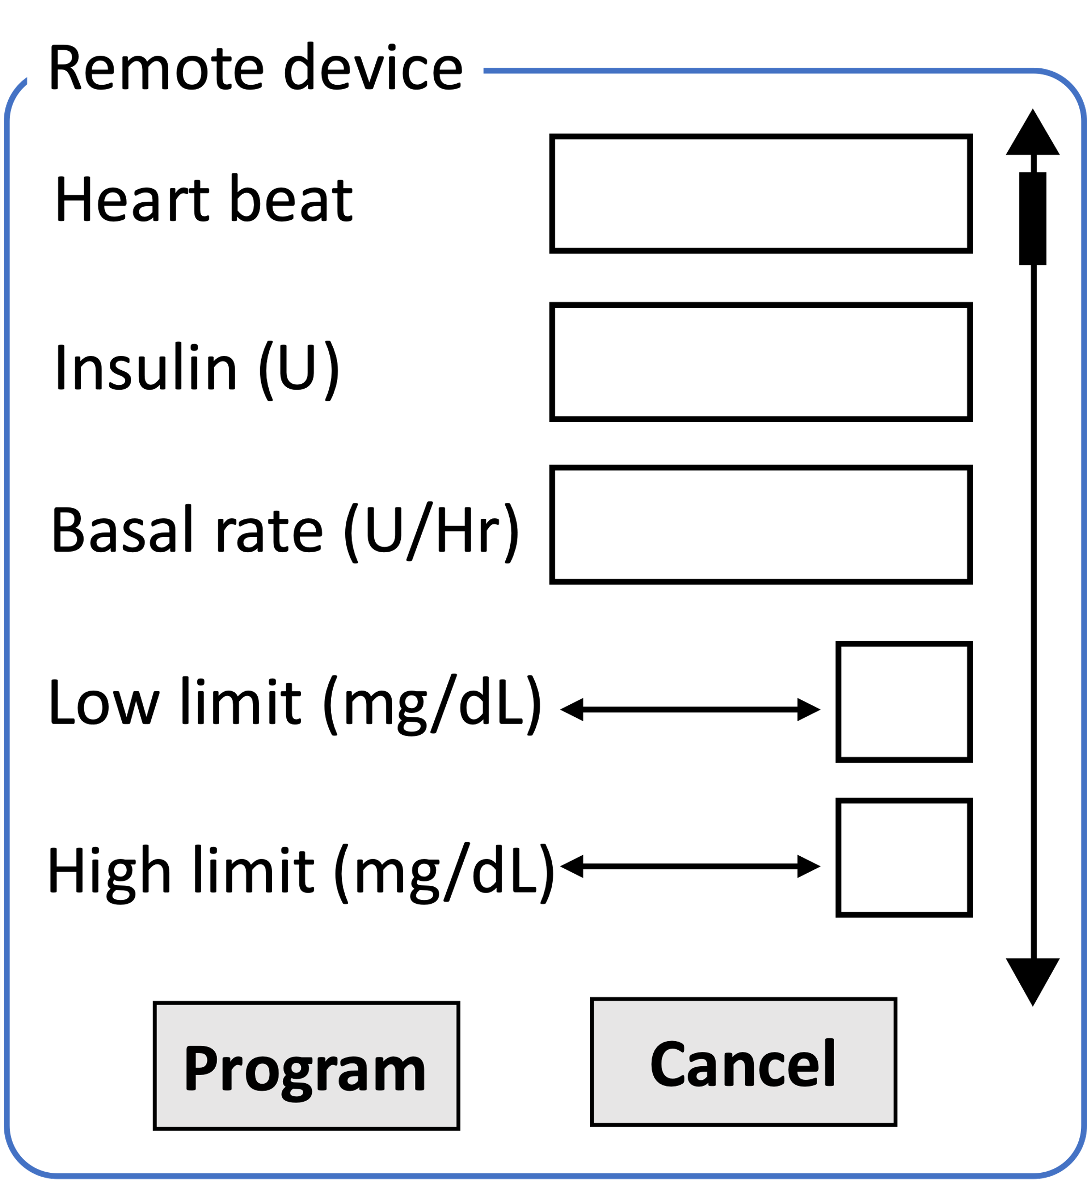
IO Integrity – UI $→$ QR Code
…
<form action="/some_action", signature = "0x45AB…", id = "0x0ab..">
<label for="insulin" secure="true">
Insulin(U)</label> <input type="text" id="insulin"
name="insulin" secure="true">
…
</form>
…
…
<img src=“form1.bmp”>
…
Simultaneous IO
ProtectIOn JS

Slide 35

IO Integrity – QR Code $→$ Overlay Generation
{
"formId": "form1",
"formName": "configure device",
"domain": "secure_site.io",
"size": "400*400",
"SAS": "5:LB",
"ui": [{
"id": "Insulin", "type": "textbox",
"label": “Insulin (U)",
"text":"",
"RE":(0-9)+},
{"id": "Heart rate",
…},
{"id":"b1",
"type": "button",
"label": "Program",
"trigger": "true"},
…],
"signature": "0x45AB...",
"id": "0x0ab.."}
Simultaneous IO

Slide 36



IO Integrity – QR Code $→$ Overlay Generation
Remote device
Verified UI from secure_site.io
Insulin (U)
Heart rate
Simultaneous IO
Basal rate (U/Hr)
Low limit (mg/cc)
High limit (mg/cc)
Program
Cancel

Slide 37


IO Integrity – Input
Remote device
Verified UI from secure_site.io
Insulin (U)
75
Heart rate
177
Simultaneous IO
Basal rate (U/Hr)
0.025
Low limit (mg/cc)
60
High limit (mg/cc)
105
Program
Cancel
ProtectIOn JS

Slide 38
User Attention for Integrity
Untrusted UI
Trusted UI Overlay
Put 1 in front of all inputs
Critical value:
Submit
Cancel

Slide 39
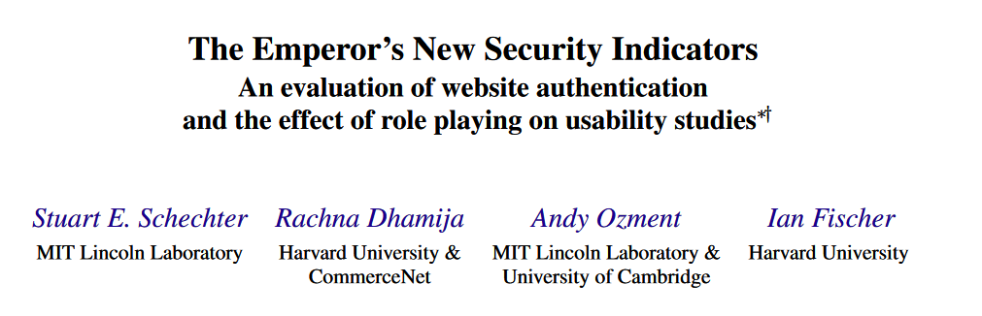
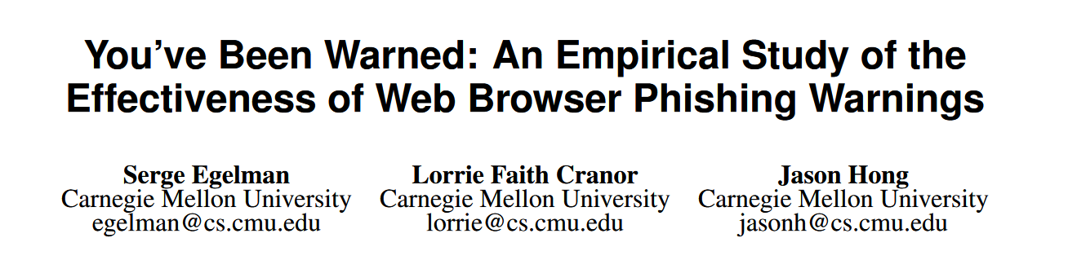
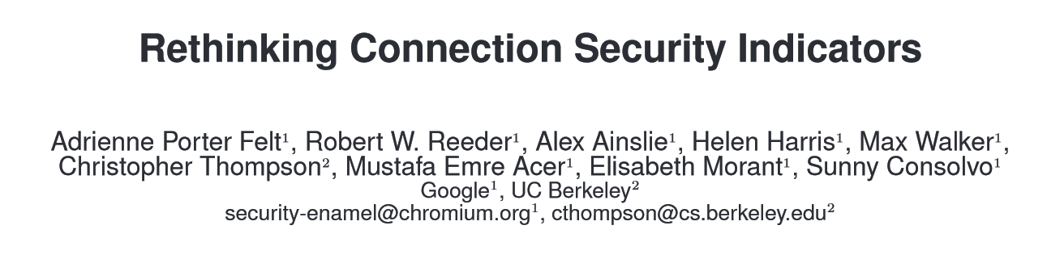
User Attention: Rethinking Security Indicators for Trusted Path
S&P 2007
CHI 2008
SOUPS 2016
Notes:
However the main challenge of designing a robust trusted path solution turned out to be how to focus user attention. Note that the user interaction with the UIs involves a lot of user attention. For trusted path, specifically for our overlay based design, its how to guide users to distinguish between the trusted part and the untrusted part of the screen. A majority of the existing research mostly avoided this crucial discussion and most of them relied on standard security indicates. Such as an icon on the screen or flashing some external LED lights. However, as some existing research pointed out that in the wild, the security indicators does not provide useful security due to the user habituation.

Slide 40
User Attention for Integrity
Untrusted UI
Trusted UI Overlay
Put 1 in front of all inputs
Critical value:
Submit
Cancel
Notes:
We wanted to integrate this attention grabbing mechanism integrated as the part of the UI that is impossible for the user to ignore. And this idea is not completely wild. Similar mechanism are proposed in 2008 as the part of the W3C security standard to fight against click jacking attack. The problem there was to distinguish between the attacker-controlled JS generated button and a button provided by the browser.

Slide 41
User Attention for Integrity
Untrusted UI
Trusted UI Overlay
Put 1 in front of all inputs
Critical value:
Submit
Cancel

Slide 42
User Attention for Integrity
Untrusted UI
Trusted UI Overlay
Put 1 in front of all inputs
Critical value:
Submit
Cancel

Slide 43
User Attention for Integrity
Untrusted UI
Trusted UI Overlay
Put 1 in front of all inputs
Critical value:
Submit
Cancel

Slide 44
Grabbing User Attention
Output Integrity: Low cognitive load
Several existing mechanisms
Low cognitive load
Put 1 in front of all inputs

Slide 45
Grabbing User Attention
Output Integrity: Low cognitive load
Several existing mechanisms
Lightbox
Low cognitive load
Put 1 in front of all inputs

Slide 46
Grabbing User Attention
Output Integrity: Low cognitive load
Several existing mechanisms
Lightbox
Highlight
Low cognitive load
Put 1 in front of all inputs

Slide 47
Grabbing User Attention
Output Integrity: Low cognitive load
Several existing mechanisms
Lightbox
Highlight
Freezing
Low cognitive load
Put 1 in front of all inputs

Slide 48
Grabbing User Attention
Output Integrity: Low cognitive load
Several existing mechanisms
Lightbox
Highlight
Freezing
Combination
Low cognitive load
Put 1 in front of all inputs

Slide 49
Grabbing User Attention
Output Integrity: Low cognitive load
Several existing mechanisms
Lightbox
Highlight
Freezing
Combination
How to determine when to engage?
Track pointer
Mouse movement on the overlay
Low cognitive load
Notes:
The main idea here is to introduce low cognitive load on the user.

Slide 50
User Attention for Confidentiality
Untrusted UI
Trusted UI
Secret value:
Secret value:
Submit
Cancel
Submit
Cancel

Slide 51
User Attention for Confidentiality
Untrusted UI
Secret value:
Submit
Cancel

Slide 52
User Attention for Confidentiality
Differs from the integrity problem
Has to be triggered by the user
Secure attention sequence (SAS)
Ctrl + Alt + Delete

Slide 53
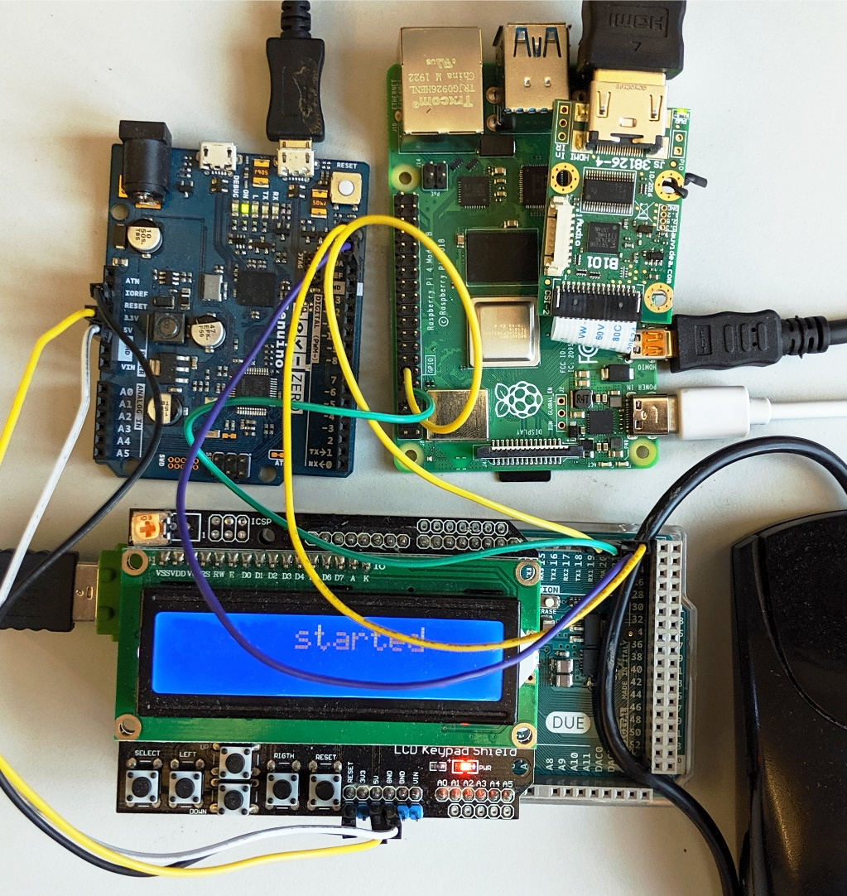









Prototype and TCB
Low TCB
Fast deployment
25.16M
20.92M
1.9K
2M
3.5K
71K
893
600K
121K
36.68M

Slide 54
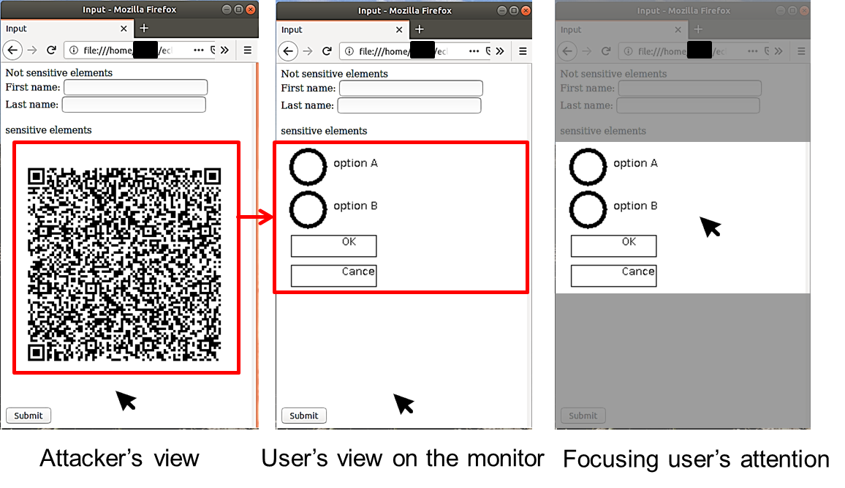

Performance
Display latency: 21.67 ms
~46 fps
Mouse latency: 250 $μs$
Keyboard latency: 170 $μs$
Pointer detection accuracy: 0.997
Notes:
Too much numbers

Slide 55
What do we learn?
Trusted path is an intractable problem
System and human interaction
Fairly crowded space
Fundamentals (simultaneous IO, input modalities…) are overlooked
Attacks on existing systems
Fundamental security properties
Human perception
Different mechanisms for Integrity, and confidentiality
How to build more systems around it

Slide 56


Thank you!

Slide 57
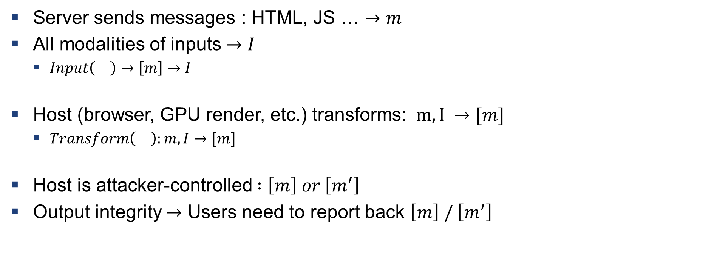
How to Build a Trusted Path
Server sends messages : HTML, JS … $→m$
All modalities of inputs $→I$
$Input\left(\right)→\left[m\right]→I$
Host (browser, GPU render, etc.) transforms: $m,I →[m]$
$Transform\left(\right):m,I→[m]$
Host is attacker-controlled $:\left[m\right] or \left[m^{′}\right]$
Output integrity $→$ Users need to report back $\left[m\right] / \left[m^{′}\right]$

Slide 58
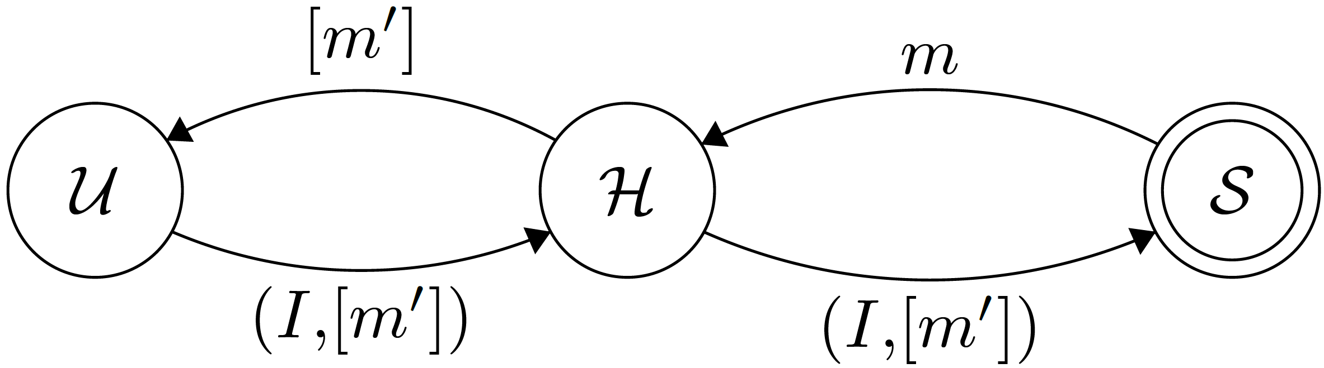
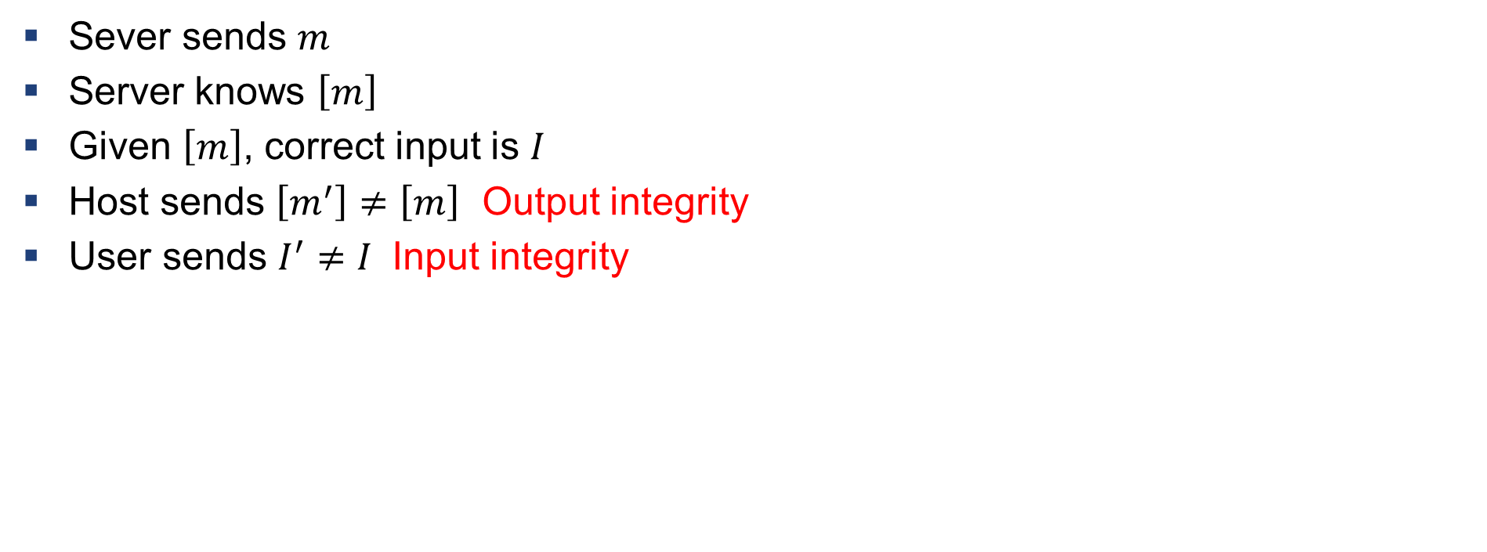
Definition: Violation of Input/output Integrity
Sever sends $m$
Server knows $\left[m\right]$
Given $\left[m\right]$, correct input is $I$
Host sends $\left[m^{′}\right]≠\left[m\right]$ Output integrity
User sends $I^{′}≠I$ Input integrity

Slide 59
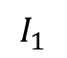
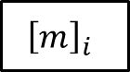
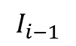
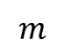
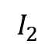
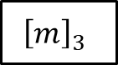
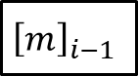
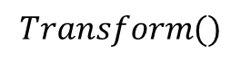
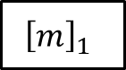
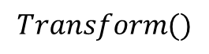
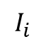
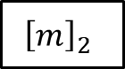

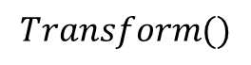
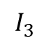
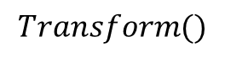
Verification
$$m$$
$$Transform()$$
$${\left[m\right]}_{1}$$
$${\left[m\right]}_{2}$$
$${\left[m\right]}_{3}$$
$${\left[m\right]}_{i−1}$$
$${\left[m\right]}_{i}$$
$$…$$
$$I_{1}$$
$$I_{2}$$
$$I_{3}$$
$$I_{i−1}$$
$$I_{i}$$
$$Transform()$$
$$Transform()$$
$$Transform()$$
Anything missing in the chain $→$ IO integrity violation

Slide 60
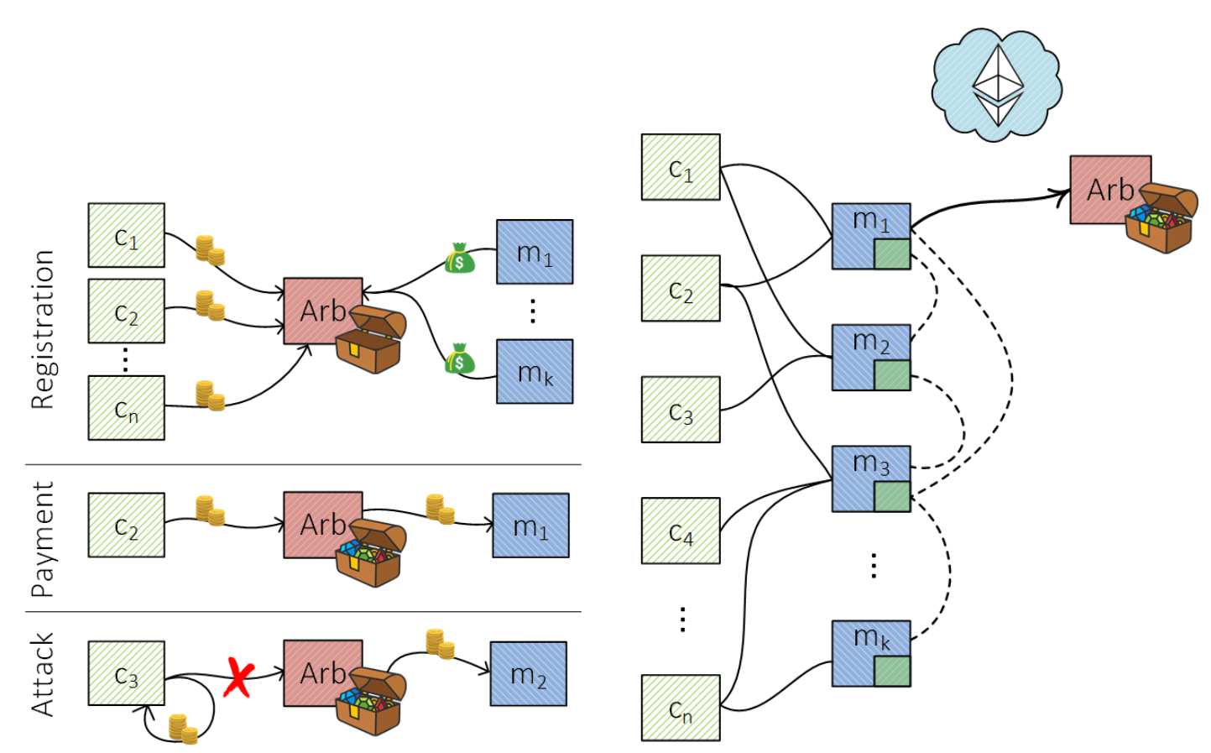
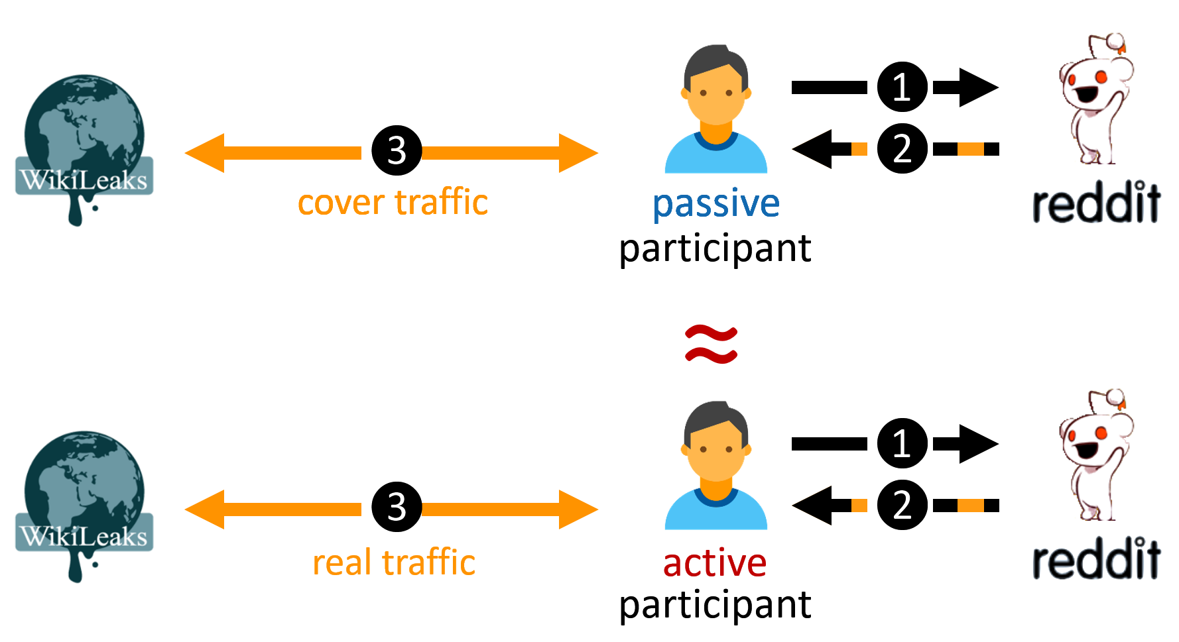
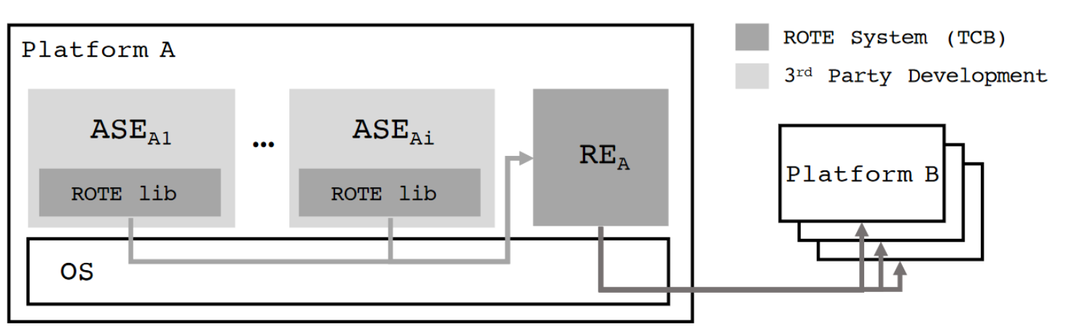
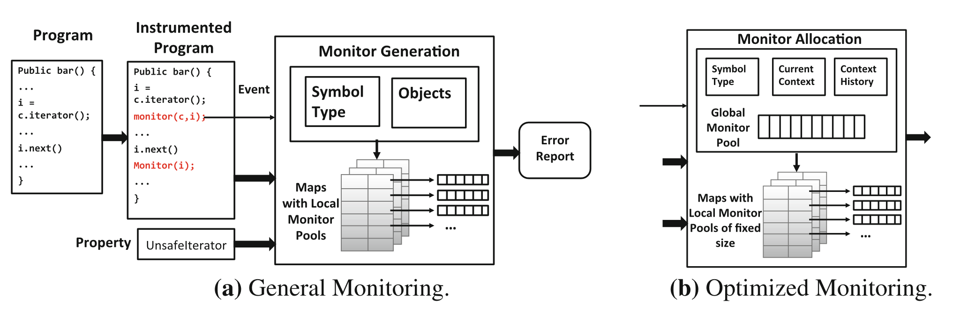
Other contributions
Fast off-chain payments
Snappy (NDSS 2020)
Anonymous communication
CoverUp (NSDI 2019)
Monitoring of type-state properties
Metis (RV 2018)
Rollback protection for SGX
ROTE (USENIX 2017)

Slide 61
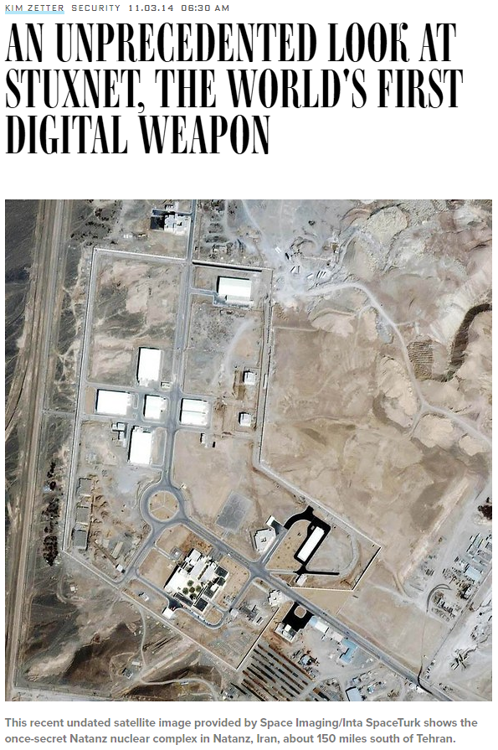
Attacks
Images are from wired, csmonitor, heimdalsecurity

Slide 62
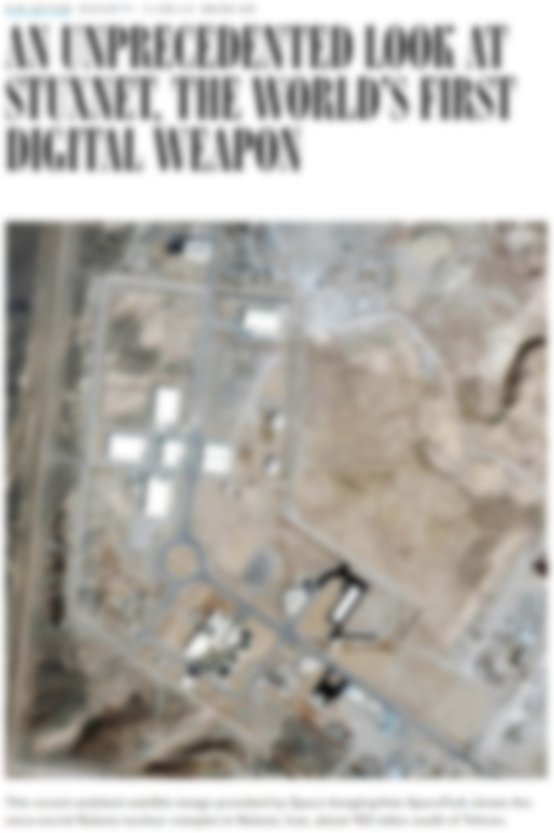
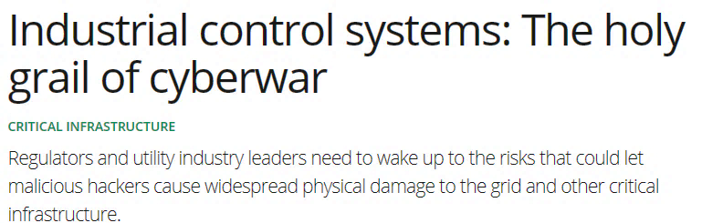
Attacks
Images are from wired, csmonitor, heimdalsecurity

Slide 63
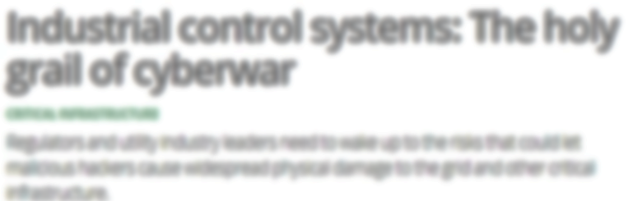
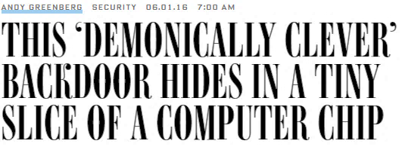
Attacks
Images are from wired, csmonitor, heimdalsecurity

Slide 64
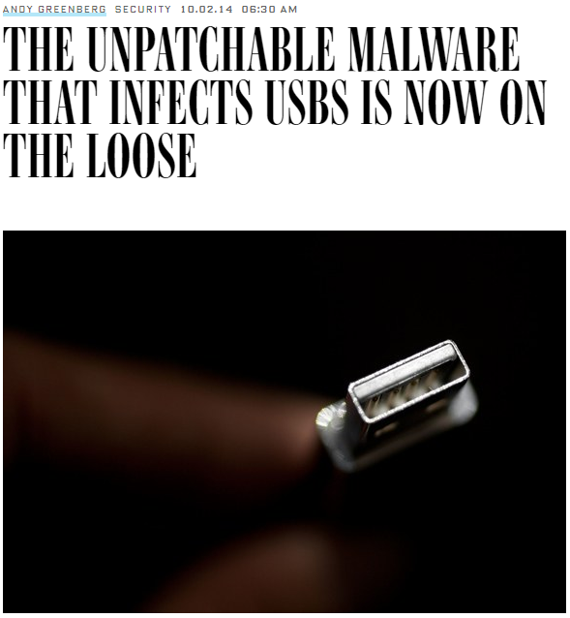

Attacks
Images are from wired, csmonitor, heimdalsecurity

Slide 65


Attacks
Images are from wired, csmonitor, heimdalsecurity

